Slide 1
NumPy

Slide 2
Outline
Universal functions
Indexing and slicing
Reshaping and transposing

Slide 3
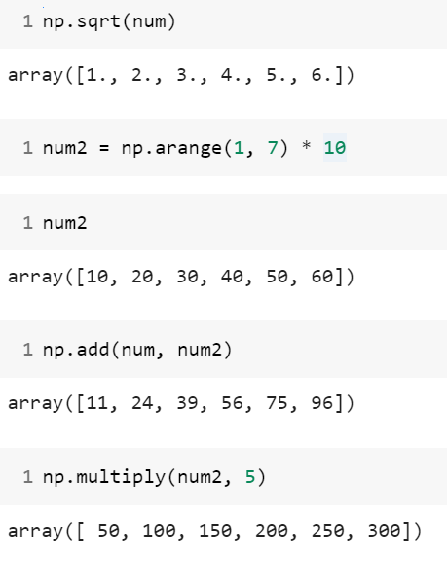
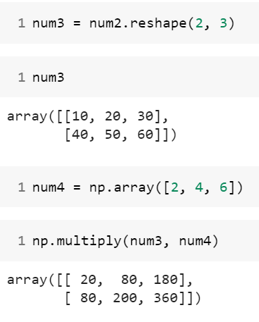
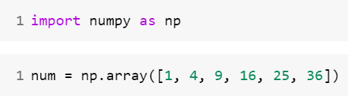
Universal functions
Array arithmetic

Slide 4
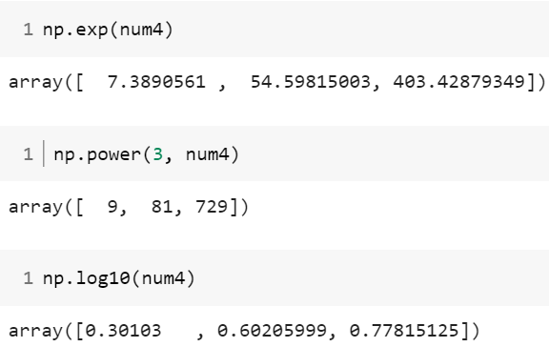
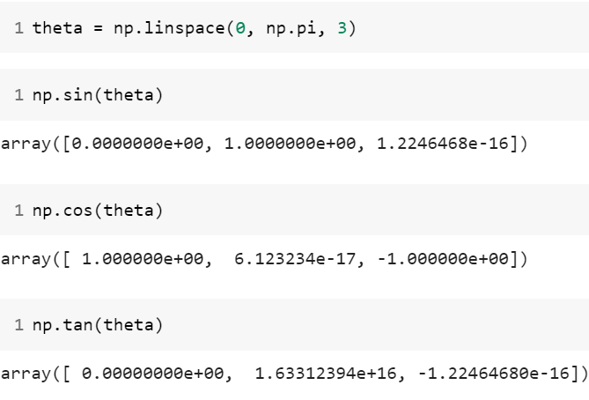
Universal functions
Exponents and logarithms
Trigonometric functions

Slide 5
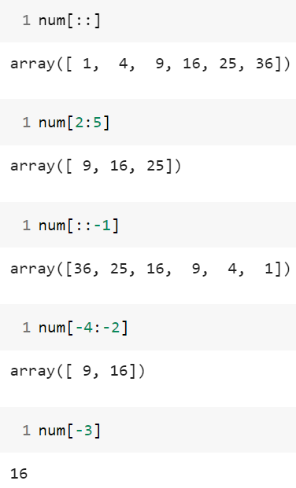
Indexing and slicing
Indexing with One-Dimensional arrays

Slide 6
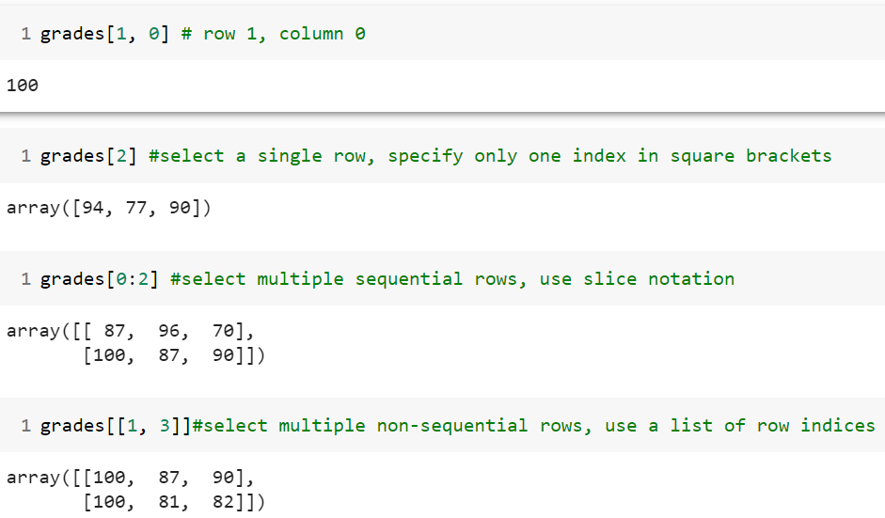
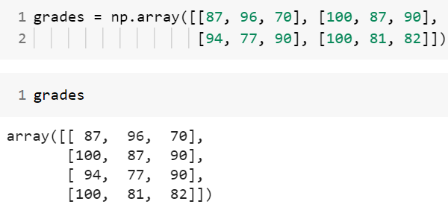
Indexing and slicing
Indexing with Two-Dimensional arrays

Slide 7
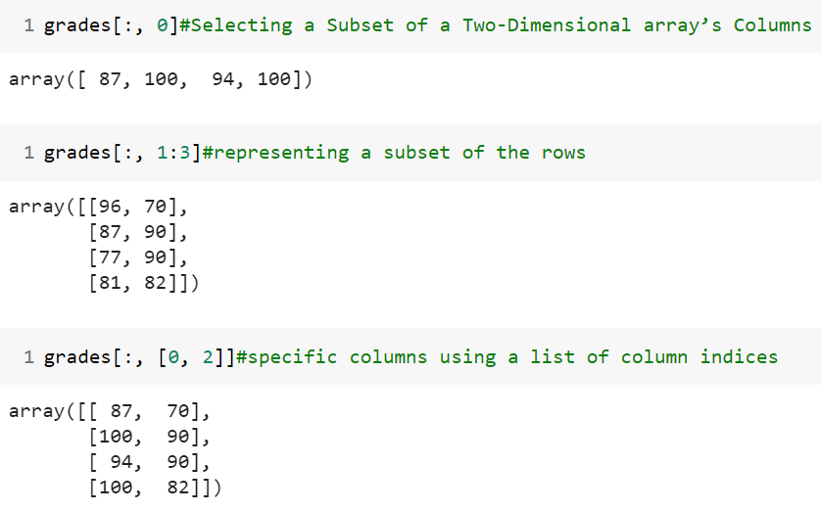
Indexing and slicing
Indexing with Two-Dimensional arrays

Slide 8
Indexing and slicing
Exercise :
Given the following array:
array([[ 1, 2, 3, 4, 5],[ 6, 7, 8, 9, 10],[11, 12, 13, 14, 15],[16,17,18,19,20])
a) Select the second row.
b) Select the first and third rows.
c) Select the middle three columns.
d) Show 12 and 13 from array.
e) Show reverse order of third rows values.
f) Select the fourth rows and find max,min,sum,mean, standard deviation and variance of values.
g) Find log10, log2, log values of rows one.

Slide 9
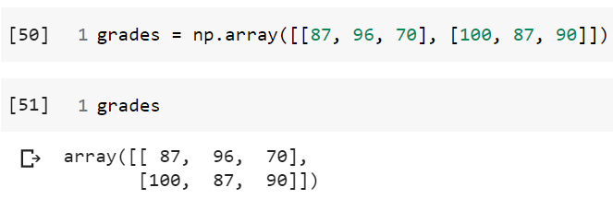
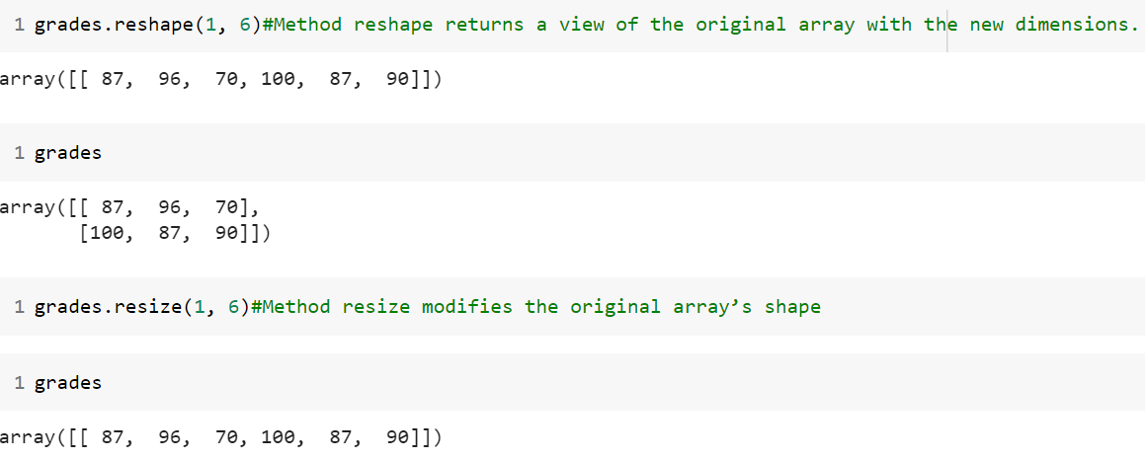
Reshaping and transposing

Slide 10
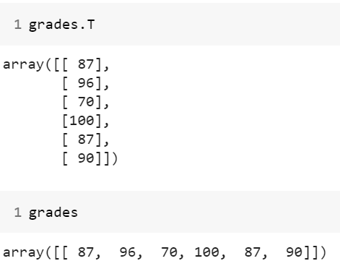
Reshaping and transposing

Slide 11
Reshaping and transposing
Exercise:
Given a 3-by-4 array:
array([[[1, 3, 2,4],[8, 6, 5,7],[11,10,12,9]]])
Find transpose of given array.
Reshape the array.
Sort the array.

Slide 12
End

